Slide 1

Weaving HealthCare Data
Vaibhav Bhandari (Microsoft, Health Solutions Group)
?
@vaibhavb #hack4health
Notes:
Welcome!
I’m Vaibhav Bhandari, Program Manager in Microsoft Health Solutions Group. Over the last three years I have worked various aspects of Microsoft HealthVault and Medical Terminologies.
Over the next 30 minutes I’m going give you a feel of working with various healthcare technologies, understanding various data sets and interface them with customers -- Weaving Healthcare Data!
Quick show of hands –
How many of you have worked in HealthCare IT for more than 5 years?
Well that’s a good number!

Slide 2
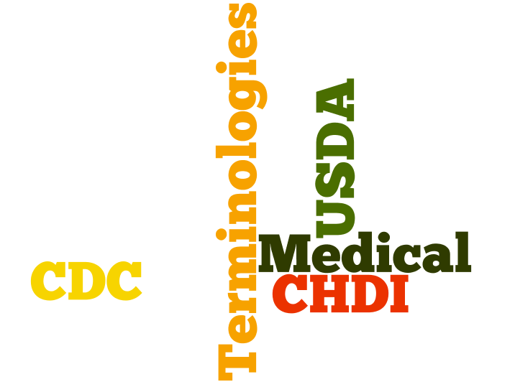
Meaningful Use
ICD-9 to ICD-10 Translation
Master Patient Index
SNOMED-CT
EMR/EHR
IHE
HL7
Notes:
Before I started working with Microsoft Software Health Solutions I was developer dealing with embedded Operating systems, file systems and device drivers! The whole world of HealthIT seemed a little overwhelming to me. Various terms like HL7, SNOMED-CT, Meaningful-use, ICD9-toICD10 Conversion, EMR & EHR were all new to me!

Slide 3
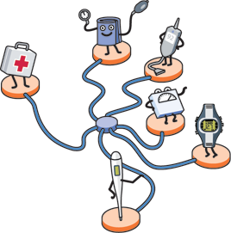



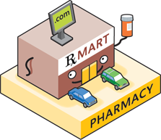


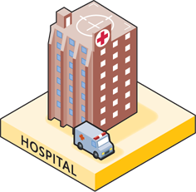
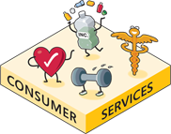
Data In Health Ecosystem
Notes:
The healthcare landscape is very complicated and often times very disjointed.
Silos are characteristic of data in the HealthCare Ecosystem. When you get sick you go your family Physician who (if at all) stores data for your visit in a local electronic medical record system. Your prescriptions get filled by a prescriptions network and Labs by the Lab network, which have their own interchange protocols and data standards. The payers or Health Plans pay for you visit using their own Electronic data interchange based standards. There are consumer service like WebMD which you use to get information from. And then there are the big Enterprise Hospitals which have a set of Silos themselves!
In a typical HealthCare Enterprise surfaces a number of disparate systems like Medication Administration, Charting, Procedure documentation, EMR etc to the Patient on the floor. In-fact a 450-bed hospital can have 100 clinical systems that never speak to each other.
Similarly on the administrative side the staff has several systems like Claims Management, Staff scheduling, Transcription etc
As a developer trying to work in this fragmented environment it can be a challenging task to even get a simple thing accomplished.
Over the next 15 minutes I’m going to illustrate what sorts of challenges you have to face to able to work effectively in the silo’ed space of the HealthCare ecosystem and the HeatlhCare enterprise.

Slide 4
Agenda
Rich Health Data Sources
CHDI – Population Health
CDC – Content
Various way to reach consumers
Windows Phone 7
HealthVault
Data Analysis Engine
Microsoft Amalga

Slide 5
Community Health Data Initiative
CHDI

Slide 6
Understanding CHDI Data Set
Tables
CountyHealthRankings
Demographics
LeadingCausesOfDeath
MeasuresOfBirthAndDeath
PreventiveServicesUse
RelativeHealthImportance
RiskFactorsAndAccessToCare
SummaryMeasuresOfHealth
VunerablePopsAndEnvHealth

Slide 7
Windows Azure CHDI Service
To develop your competition entries feel free to use the following service (limited time only) :
http://chdisourcedataservice.cloudapp.net/Chdi.svc/

Slide 8
Interesting Ideas
Interleave them on bing or google maps!
Use interesting visualization tools to showcase the data
E.g. Javascript InfoVis - http://thejit.org/
Pair this information with data from other organizations!

Slide 9
CDC Content Data Source
Content Syndication Site
http://tools.cdc.gov/register/default.aspx
Example
Tobacco Use

Slide 10
Interesting Resources
HHS Data Sets
http://www.hhs.gov/open/datasets/communityhealthdata.html
My family health portrait
https://familyhistory.hhs.gov/fhh-web/home.action

Slide 11
Interacting with consumer Health Data
HealthVault

Slide 12




Moving Patient Data
Lab
Emergency
EMR
Health Plan
Notes:
Jim would love to get more information on the care.
The labs feature application which you added to the outpatient system can now be extended to send the information to the patient through one of the Personally Controlled Health Records (Google, Dossia or Indivo).

Slide 13
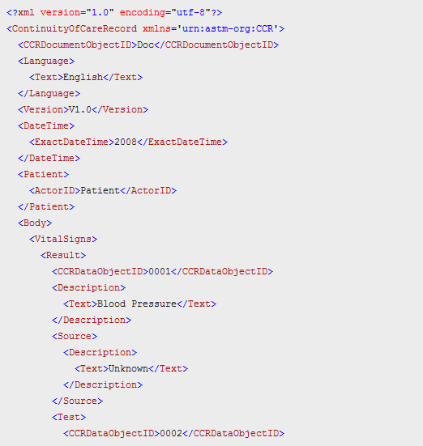
CCR
Lab
Emergency
EMR
Health Plan
Notes:
Now, that Jim is ready to go home – we want to send an CCR/CCD/C32 to his Personally Controlled Health record. Lets take example of HealthVault.
Your application create a CCR for Jim’s visit which shows his Vital signs, Lab Results.
For a developer HealthVault has a number community managed Open Source libraries, we will work with the Python library on code.google.com or Jave on Codeplex.
Our emergency EMR takes the information from its database and converts it to a CCR using CCR xsd.

Slide 14
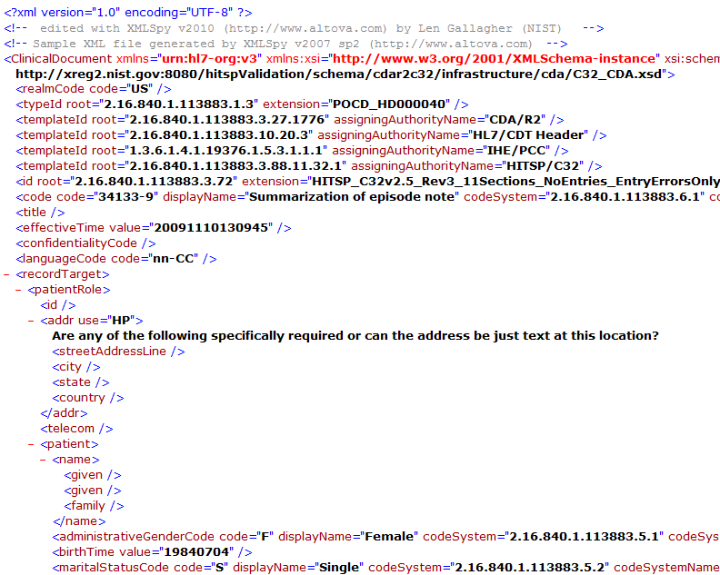
CCD or C32

Slide 15
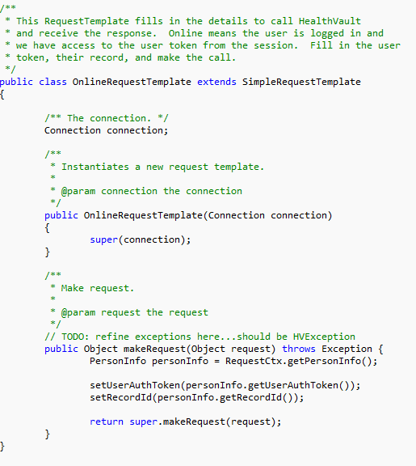
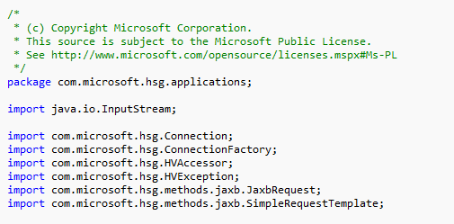
HealthVault Interaction
Notes:
This snippet show how the application can drop-off the CCR in to HealthVault

Slide 16

Leaving the Clinical Silo
Clinical Silo
While in enterprise your application need to comply with HIPAA 5010
When Jim log’s in to HealthVault then the data is flowing in to consumer domain
Lab
Emergency
EMR
Health Plan
Notes:
The data is now flowing out of the hospital in to HealthVault. A critical distinction is that its no longer HIPAA covered.

Slide 17
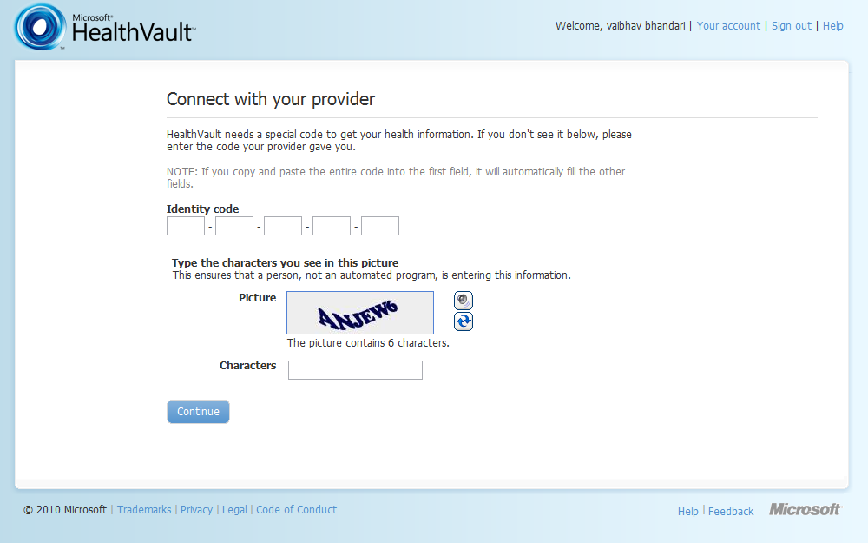
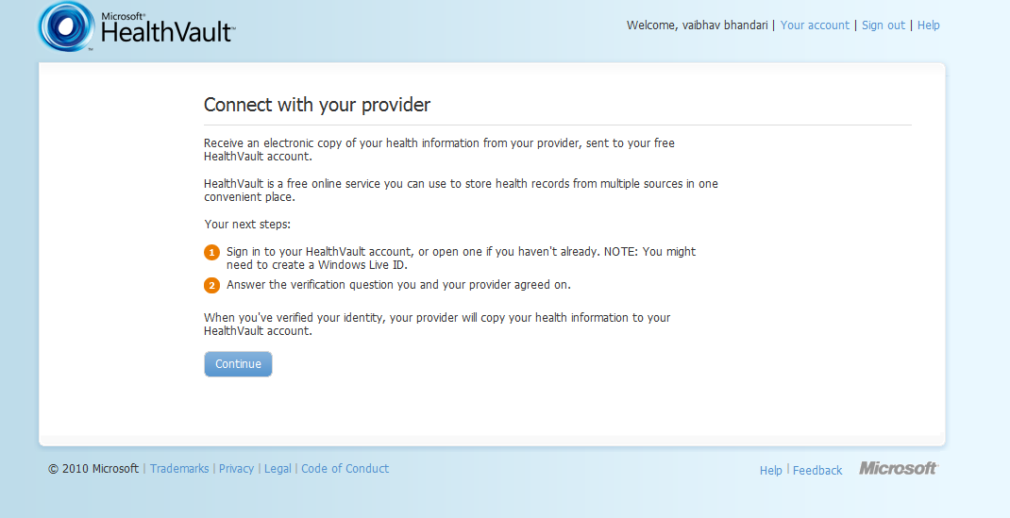
Direct To Clinical
Notes:
Once Jims get’s to his home computer or Mobile phone be can enter the code given to him by the Emergency EMR and receive this CCR in to his HealthVault account. He can choose further refine it by reconciling it to HealthVault data types.
..

Slide 18
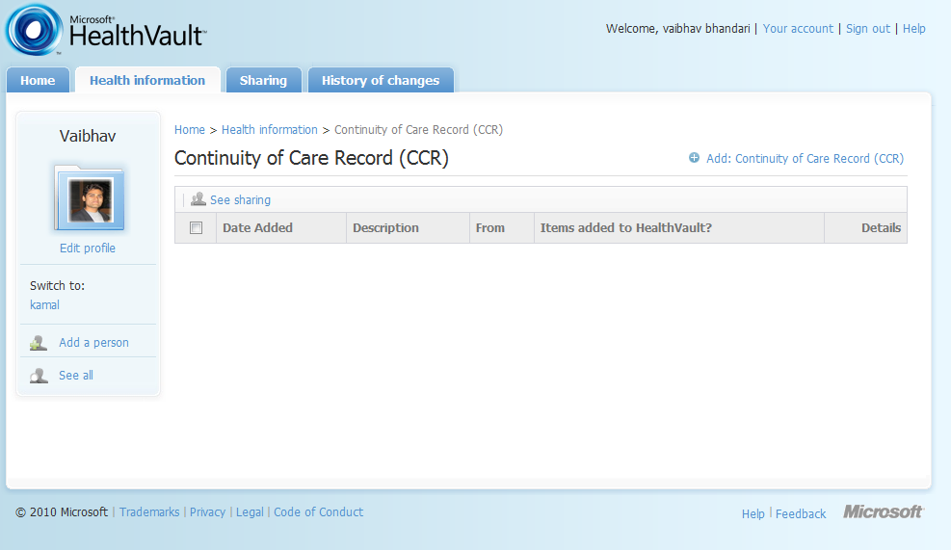
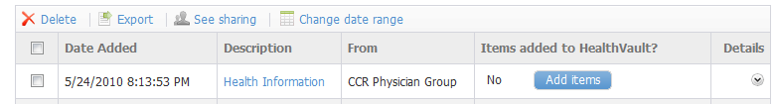

Data In User’s Account
Lab
Emergency
EMR
Jim
Health Plan
Notes:
This is a great opportunity for developers in general to enable a cheap and easy way for providers to send information directly to end users.
Providers are eagerly looking for such capabilities as meaningful use requires that capability.
Employer sends 834 to HealthPlan for enrolling a patient.
HealthPlan or Mediclaim or Medicare maintain a member index which Hosiptal can query using 271.
278 – Is authorization request (in some states and Canada this is pre-determination).
The claims processing system sends message 837/835 (Claims Processing message) which includes patients demographics, details of plan and details of the transaction (how much the plan paid and how much is co-pay).
Vendors in space – Unisys, ACS, MUMPs (open source).

Slide 19
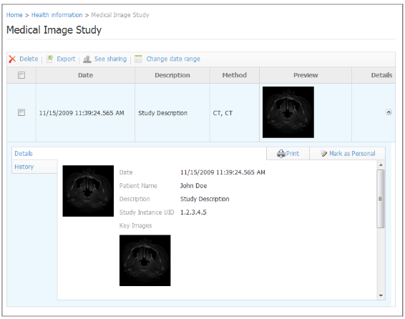
HealthVault Medical Imaging
Notes:
If your application wanted you could also have sent the medical images from Jim’s Visit to his HealthVault account. We have recently enabled storing large data in HealthVault.
We have a detailed walk through for using this functionality with Java.

Slide 20
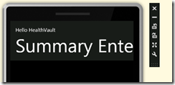
HealthVault Mobile Client Application
Notes:
In addition to Medical Images your application can also use the Client Capability of HealthVault platform and in-fact create client applications for Android or Windows Mobile.
Details of this can be found on my blog.
May be the future phone can detect and transact with hospital devices to get a care record instead of going through a CCR/CCD hoops.

Slide 21
HealthVault Resources
Community Promise
Open Source SDKs
Java : CodePlex
Ruby : RubyForge
Python : Google Code
PHP: SourceForge
Reference License .NET SDK
http://msdn.microsoft.com/healthvault

Slide 22
Key Takeaways
Rich Health datasets in various domains
CHDI population data
CDC content
HealthVault offers a complete and easy to use platform to reach consumers in various ways
Imaging
Mobile

Slide 23
Microsoft @ Health2.0
Platinum Event Sponsor & Hackathon Sponsor
Showcase: The Health 2.0 Developer Challenge (Thursday, October 7th @11:45am)
Microsoft submitted challenge response to Markle Blue Button Challenge
Community Health Data Initiative & Blue Button: What’s Next? (Thursday, October 7th @ 12:45 – 1:45pm)
Sean Nolan, Distinguished Engineer, Microsoft HSG is panelist & will demo
Tools and Unplatforms Part I: The Data Utility Layer (Friday, October 8th @ 9am)
David Cerino, General Manager, Microsoft HSG is panelist
Microsoft solutions showcased in Accelerator Demos
Tools and Unplatforms Part II: the Emerging Consumer Ecosystem (Friday, October 8th @11am)
David Cerino, General Manager, Microsoft HSG is panelist

Slide 24

Thank You
Be Well. Be Protected.
?
@vaibhavb #hack4health

